Slide 2
Cerner Code Learning Lab CHC 2019
SMART on FHIR Authorization
Hank DeDona
Cloud Identity and Access Management
Notes:
SECTION SLIDE: Right-click image to replace.
**Slide not built in master slides due to the ability to swap out images.

Slide 3
Introduction
This is an overview of Cerner’s authorization guide to help you get started. The full authorization guide, along with further security background information, may be found at:
http://fhir.cerner.com/authorization/
Notes:
Basic one column slide.
This slide can also be used as a NASCAR SLIDE, where we want to show multiple partner/client logo or the like.

Slide 4
SMART® on FHIR® Recap
Notes:
SECTION SLIDE: Right-click image to replace.
**Slide not built in master slides due to the ability to swap out images.

Slide 5
Introduction
SMART® provides:
A framework to launch client applications from either an EHR or a patient portal workflow.
A framework to let client applications obtain access to FHIR resources on behalf of the user.
A framework to share the user’s context in the EHR or patient portal.
Notes:
Basic one column slide.
This slide can also be used as a NASCAR SLIDE, where we want to show multiple partner/client logo or the like.

Slide 6
Introduction
How does it accomplish this?
Extends OAuth2 Framework (IETF RFC 6749)
Utilizes OpenID Connect identity tokens for conveying user identity.
Defines additional extensions and mechanisms outside of the core OAuth 2 framework to handle healthcare use cases.

Slide 7
Why Utilize the OAuth 2 Framework?
Notes:
SECTION SLIDE: Right-click image to replace.
**Slide not built in master slides due to the ability to swap out images.

Slide 8
Introduction
Reason: It abstracts authentication away from client applications.
Benefit: Organizations can choose any mechanism(s) of authentication that are appropriate for its user population without affecting apps.
Benefit: Users can have an “single sign-on” experience, and don’t have to update apps if they change their credentials.

Slide 9
Introduction
Benefit: Apps aren’t directly handling user credentials; this is beneficial to all parties from a security perspective.
Benefit: As a framework based on trust-exchange, the EHR does not have to extend the entirety of authorization rights of a given user to your app – only those needed to function.
This, in turn, can lower risk to organizations, patients, and your application.

Slide 10
Introduction
Reason: As a security framework, OAuth has a tremendous amount of investment from the security community.
Benefit: The SMART® on FHIR® ecosystem can benefit from further security research and improvements being added to OAuth in the future.
Benefit: Tools, education, articles, etc., covering the OAuth framework are commonly available.

Slide 11
Overview: Working with the OAuth 2 Framework
Notes:
SECTION SLIDE: Right-click image to replace.
**Slide not built in master slides due to the ability to swap out images.

Slide 12
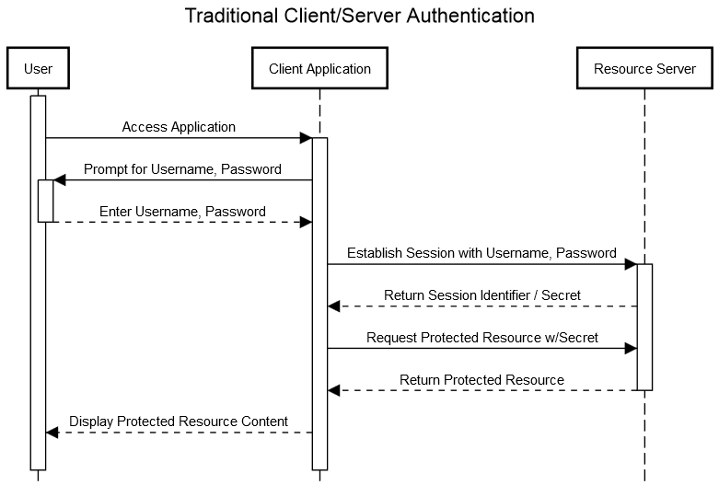

Slide 13
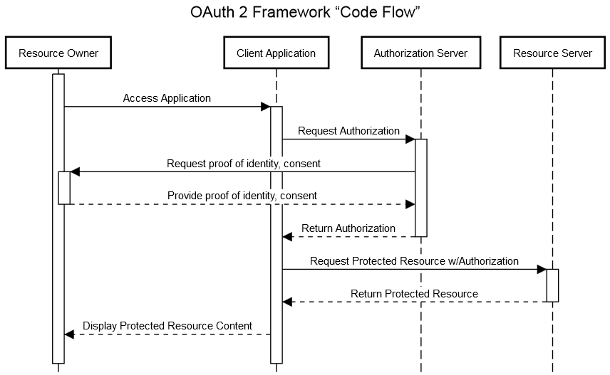

Slide 14
What does my application need to get started?
Notes:
SECTION SLIDE: Right-click image to replace.
**Slide not built in master slides due to the ability to swap out images.

Slide 15
Getting Started
client identifier: A unique* identifier, assigned to your client application.
authorization endpoint: Used to interact with the resource owner and obtain an authorization grant. The authorization server MUST first verify the identity of the resource owner.
token endpoint: Used by the client to obtain an access token by presenting its authorization grant or refresh token.

Slide 16
Getting Started
redirection endpoint: A URI to which the authorization server will send the user-agent back once access is granted (or denied).
scope: The extent of access being requested by an application during grant and token requests.
client credentials: secret material “used for authenticating with the authorization server (e.g., password, public/private key pair).” (optional based on workflow)

Slide 17
“Authorization Code” Flow
+----------+
| Resource |
| Owner |
| |
+----------+
^
|
(B)
+----|-----+ Client Identifier +---------------+
| -+----(A)-- & Redirection URI ---->| |
| User- | | Authorization |
| Agent -+----(B)-- User authenticates --->| Server |
| | | |
| -+----(C)-- Authorization Code ---<| |
+-|----|---+ +---------------+
| | ^ v
(A) (C) | |
| | | |
^ v | |
+---------+ | |
| |>---(D)-- Authorization Code ---------' |
| Client | & Redirection URI |
| | |
| |<---(E)----- Access Token -------------------'
+---------+ (w/ Optional Refresh Token)

Slide 18
Lab 1: Authorization Code Flow
These labs use Cerner’s “Authorization Demo”. This web site allows developers to experiment with SMART® on FHIR® authorization servers and see the OAuth protocol interactions in action.
http://bit.ly/2uV5OlQ

Slide 19
Authorization Code Flow
Notes:
SECTION SLIDE: Right-click image to replace.
**Slide not built in master slides due to the ability to swap out images.

Slide 20
Authorization Code Flow
High-level steps:
Construct an authorization request URL.
Open the URL in an appropriate user-agent.
User / user-agent interaction occurs.
Parse and validate the grant response.
Request a token using the code from the grant response.
Parse the token response.
Utilize the token to access a protected resource.

Slide 21
Authorization Code Flow
The authorization grant requests and responses are passed using an x-www-form-urlencoded query string, appended to the authorization endpoint and redirection URIs, respectively.

Slide 22
Authorization Code Flow
Query parameters in the authorization request:
client_id: The identifier of your client application.
state: The “state” parameter, sent by your application, used to verify that the code did not originate from another device (cross-site attacks.)
scope: The space-delimited scopes your application is requesting.
aud: The base FHIR URL
grant_type: constant value of “authorization_code”

Slide 23
Authorization Code Flow Example
https://authorization.devcerner.com/tenants/pi2Au6O6r-41IDt-griqAFji_BB2UQv6/protocols/oauth2/profiles/smart-v1/personas/patient/authorize
?client_id=a4359119-130e-4b2b-95d4-3d94b40b8db4
&response_type=code
&scope=openid%20online_access%20
&aud=https%3A%2F%2Ffhir.devcernerpowerchart.com%2F &state=f7eb3163-a189-4c30-93d6-bd7e7657e857

Slide 24
Authorization Code Flow
Query parameters returned in the grant response:
code: A one-time use code that may be exchanged by your application for an access token.
state: The “state” parameter, sent by your application, used to verify that the code did not originate from another device (cross-site attacks.)

Slide 25
Authorization Code Flow Response
https://authz-demo.devcerner.com/client/demo/cb
?code=c5326658-ed43-4036-af90-a35bf689f010
&state=f7eb3163-a189-4c30-93d6-bd7e7657e857

Slide 26
Authorization Code Flow
Other parameters may appear in the case of an error:
error: An OAuth2 error code, indicating why the grant request was rejected.
error_uri: A URI to be displayed to the user as a link, providing the user (or developer or support personnel) with more information as to why the request failed.

Slide 27
Authorization Code Flow
Validate the state parameter matches the value originally chosen when the request was initiated. If the value does not match, or you receive a grant code unexpectedly, this could be an attempted “cross-site request forgery” or a “session-fixation”-style attack.

Slide 28
Authorization Code Flow
Token requests are encoded as an x-www-form-urlencoded string, sent via HTTP POST to the “token” URL.
grant_type: constant value of “authorization_code”.
client_id: the client identifier of your app.
code: the code received in the authorization grant response.

Slide 29
Authorization Code Flow
Token responses are encoded as application/json, and contain the following name/values:
access_token: A “bearer” token that is used to access FHIR® services.
scope: The list of scopes that were approved by the authorization server and/or end user.
expires_in: The duration (in seconds) that the token will last.

Slide 30
Authorization Code Flow
A single token generally does not last more than 10 minutes; if longer access is required, you will need a “refresh token”, obtained via the scope of “online_access” or “offline_access”
(more information later in this presentation.)

Slide 31
Authorization Code Flow
Error responses may also be returned, with the following values present in the JSON response:
error: An OAuth2 error code, useful for troubleshooting.
error_uri: Similar to the error_uri in the authorization grant response, a value to link to the user for further assistance, and useful for developers and support personnel for troubleshooting.

Slide 32
Authorization Code Flow
Add an authorization header to your HTTP requests, including the access_token value as a “Bearer” token:

Slide 33
Authorization Code Flow
If the token is invalid, or otherwise not authorized for the resource/method being invoked, you will receive a corresponding 401/403 response with a “WWW-Authenticate” header.

Slide 34
Lab 2: Utilizing an Access Token
Let’s repeat the series of steps again from the first lab, but this time, we will access a protected resource using the resulting bearer token.
http://bit.ly/2tA7KMT

Slide 35
Scopes
Notes:
SECTION SLIDE: Right-click image to replace.
**Slide not built in master slides due to the ability to swap out images.

Slide 36
Scopes
Scopes provide a means for a client application to:
“Ask” for specific permissions
Negotiate permissions between client, server, and resource owner.
Request tokens with fewer permissions for use with other (possibly third-party) microservices.

Slide 37
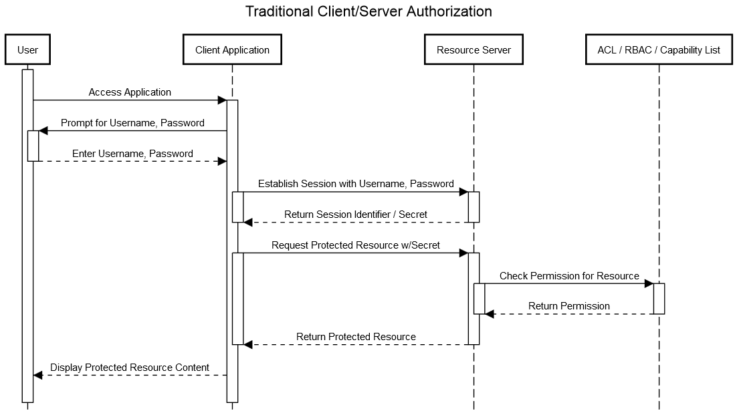

Slide 38
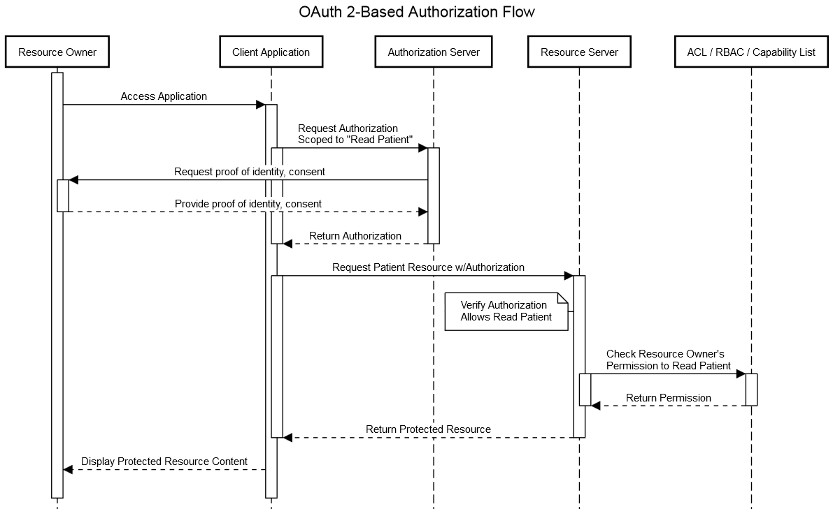

Slide 39
Scopes
The structure of scopes, as defined by FHIR:
scope-name = resource-context "/" resource-type "." modification-rights
resource-context = ("user" / "patient")
resource-type = (Name / "*")
modification-rights = ("read" / "write" / "*" );

Slide 40
Scopes
Example Scope: patient/Observation.write
Allows your application to modify or create records in the Observation resource, constrained to a single patient currently in context, subject to the limits of the authenticated user.

Slide 41
Scopes
Example Scope: user/MedicationHistory.read
Allows your application to read from the MedicationHistory resource from any record the authenticated user has access to.

Slide 42
Scopes
Example Scope: user/Immunizations.*
Allows your application to read, modify, or create records in the Immunization resource, subject to the limits of the authenticated user.

Slide 43
Scopes
Scopes are combined using spaces. Example:
user/Observation.read user/MedicationHistory.read online_access

Slide 44
Scopes
Your application may not always receive full access to the scopes requested in the original grant – make sure to validate you received the scopes you need to function.

Slide 45
Lab 3: Scopes
In this lab, we’ll attempt to access a different resource and request the scope necessary for access.
http://bit.ly/2tA9KEY

Slide 46
Special Scopes
Other “special” scopes offered in SMART on FHIR:
openid: Returns an identity token containing the authenticated “principal” identifier for the user.
fhirUser / profile: Used in conjunction with openid, provides access to the authenticated user’s demographics through a specific FHIR resource.
launch: Requests access to information associated with a SMART on FHIR launch received by your application.

Slide 47
Special Scopes
Other “special” scopes offered in SMART on FHIR:
online_access: Allows your application to obtain a “refresh token”, such that your application can continue to operate as long as the user possesses an active session with the EHR.
offline_access: Allows your application to obtain a “refresh token”, such that your application can operate even when a user is not authenticated.

Slide 48
Special Scopes
Other special scopes not currently supported:
launch/patient*
launch/encounter
launch/location

Slide 49
Discovery
Notes:
SECTION SLIDE: Right-click image to replace.
**Slide not built in master slides due to the ability to swap out images.

Slide 50
Discovery
SMART® on FHIR® provides a mechanism to determine the authorization and token endpoints associated with the FHIR® service via a conformance resource / capability statement.

Slide 51
Example Conformance Content
"extension": [
{
"url": "http://fhir-registry.smarthealthit.org/StructureDefinition/oauth-uris",
"extension": [
{
"url": "token",
"valueUri": "https://authorization.sandboxcerner.com/tenants/0b8a0111-e8e6-4c26-a91c-5069cbc6b1ca/protocols/oauth2/profiles/smart-v1/token"
},
{
"url": "authorize",
"valueUri": "https://authorization.sandboxcerner.com/tenants/0b8a0111-e8e6-4c26-a91c-5069cbc6b1ca/protocols/oauth2/profiles/smart-v1/personas/patient/authorize"
},
{
"url": "manage",
"valueUri": "https://authorization.sandboxcerner.com/tenants/0b8a0111-e8e6-4c26-a91c-5069cbc6b1ca/personas/patient/my-authorizations"
}
]
}
],

Slide 52
Lab 4: Discovery
In this lab, we’ll fetch the conformance document and see how the endpoints are used by a SMART® application.
http://bit.ly/2h0L4DG

Slide 53
Launch
Notes:
SECTION SLIDE: Right-click image to replace.
**Slide not built in master slides due to the ability to swap out images.

Slide 54
Launch
The SMART® framework provides a mechanism for applications to be “launched”. A “launch” passes two pieces of information to your application’s pre-registered launch endpoint:
iss: The FHIR® base URL of the EHR performing the “launch” (or “issuer”).
launch: A “launch” identifier, used by the EHR to associate the subsequent authorization request with context in the EHR.

Slide 55
Launch
Additional information may be returned in the JSON of a token response upon completion of the authorization flow:
patient: The FHIR® identifier of a Patient resource of the current patient in context. Present during “launch”.
need_patient_banner: a boolean, present during launch, indicating whether a patient banner should be displayed.

Slide 56
Lab 5: Launch
In this lab, we’ll observe how launch is leveraged by the demo application and how launch effects contextual (“patient/…”) scopes.
http://bit.ly/2h0L72k

Slide 57
OpenID Connect / User Identity
Notes:
SECTION SLIDE: Right-click image to replace.
**Slide not built in master slides due to the ability to swap out images.

Slide 58
OpenID and User Identity
Many applications have a need to determine the identity of the user the application is acting on behalf of. Example reasons:
Display of username in application
Auditing / logging
Protecting non-FHIR resources

Slide 59
OpenID and User Identity
The openid scope allows an application to request an identity token (defined as part of the OpenID Connect specification*).
The fhirUser scope (in previous versions, profile) requests the URL of the authenticated user’s FHIR resource. The information from this resource allows applications to tie user identity back to the specific person (practitioner, patient, or otherwise.)

Slide 60
OpenID and User Identity
OpenID responses come in the form of an id_token that is returned in the access token response.
id_token(s) are JSON Web Tokens and are generally signed using the JSON Web Signature specification (more details provided in the lab.)

Slide 61
OpenID and User Identity
Tokens contain an issuer (“iss”) and a subject (“sub”). The combination of these represents a globally-unique identifier for a user.
Subject values are only unique within the context of the issuer of the token (two different issuers might assert the same subject values.)
The subject is not guaranteed by all implementations to be an actual username, nor does FHIR® offer a standard mechanism to obtain a “username” via a resource.

Slide 62
OpenID and User Identity
Some authorization server implementations may choose not to sign such tokens.
In such cases, the “issuer” value MUST match the URL of the token endpoint from which you are receiving the id_token.
Cerner’s implementation does sign identity tokens; further information on how to verify such tokens may be found in our online documentation and as part of the labs.

Slide 63
Lab 6: OpenID
In this lab, we’ll observe how the openid scope is used.
http://bit.ly/2uWqmKi

Slide 64
Refresh Tokens
Notes:
SECTION SLIDE: Right-click image to replace.
**Slide not built in master slides due to the ability to swap out images.

Slide 65
Refresh Tokens
Access tokens are valid for short durations.
If your application needs access for a longer duration (> 10 minutes), your application needs the ability to automatically obtain new tokens.

Slide 66
Refresh Tokens
With the scopes of online_access or offline_access, you can obtain additional tokens.
A “refresh_token” is returned in the token response when this scope is granted. This token can be used to obtain new tokens from the authorization server.

Slide 67
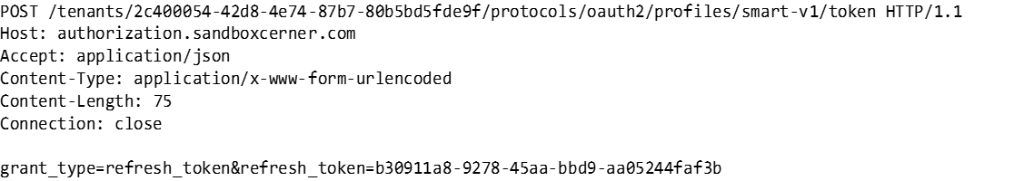
Example Refresh Token Request

Slide 68
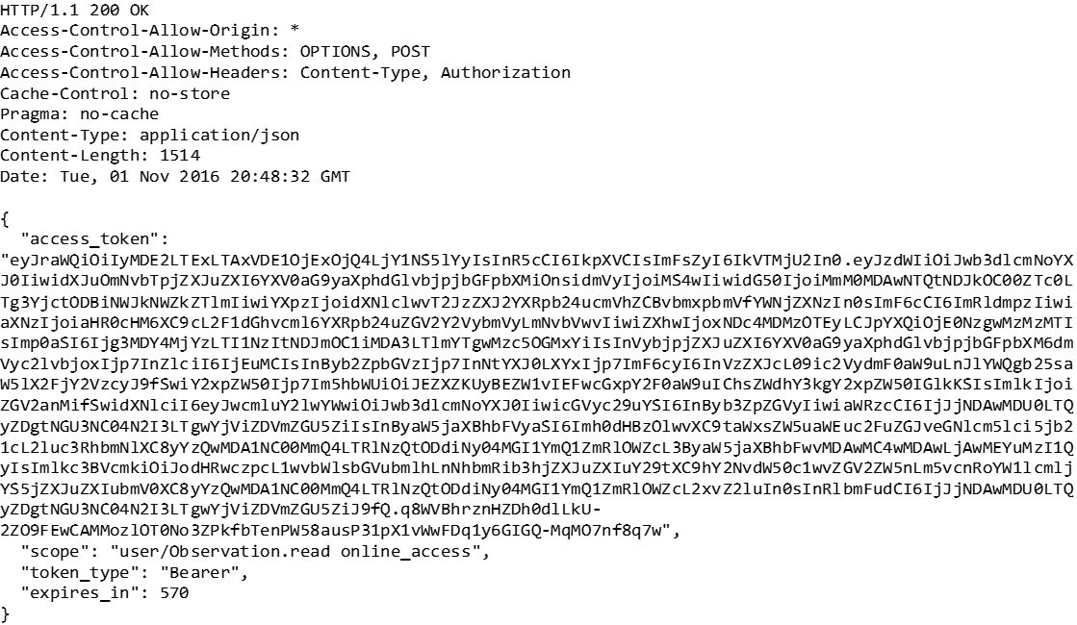
Example Refresh Token Response

Slide 69
Refresh Tokens
Refresh token responses may not contain the additional response parameters that were included in the original grant, such as the “patient” value seen during a launch.

Slide 70
Refresh Tokens
“offline_access” refresh tokens may require “client credentials” to utilize.
In Cerner’s ecosystem, Cerner Central system account credentials are required for use with such refresh tokens, sent via HTTP Basic authentication.

Slide 71
Refresh Tokens
Refresh tokens will continue to function until either:
The user’s session (“online_access”) is terminated or risk-based re-authentication is required (logging out, expiration, other security events).
The user or their administrator terminates the persistent grant (“offline_access”) via “manage authorizations”.
The organization terminates all access for your application to their FHIR® services.

Slide 72
Lab 7: Refresh Tokens
In this lab, we’ll observe how the online_access scope is used, and how refresh tokens are utilized.
http://bit.ly/2uuj7Zy

Slide 73
Exception Cases
Notes:
SECTION SLIDE: Right-click image to replace.
**Slide not built in master slides due to the ability to swap out images.

Slide 74
Handling Errors
All workflows in the OAuth 2 framework allow for an error_uri parameter to be returned to the client application.
If your application receives an error, at minimum provide a link to the user using the value of error_uri – this will help in diagnosing the cause and guiding the user to support.

Slide 75
Common Error Cases
Forgetting to send the “aud” (audience) parameter. This parameter is not part of the core OAuth 2 framework, but is unique to the security requirements of the SMART® ecosystem.
Authorization grant codes are one-time use codes. Submitting a token request twice using the same authorization grant code will result in an error.
If you include a redirect_uri in your authorization request, it must match the scheme, host, port, and path (including trailing slashes) that was registered with the authorization server.

Slide 76
Lab 8: Exception Cases
In this lab, we’ll observe how these common errors manifest themselves, as well as the error page provided by the authorization server.
http://bit.ly/2v5Kv1o

Slide 77
Miscellany
Notes:
SECTION SLIDE: Right-click image to replace.
**Slide not built in master slides due to the ability to swap out images.

Slide 78
UX Considerations
For applications that “stand-alone” (Applications that are not embedded within the EHR via web view technology):
Use a separate browser tab / window for authorization flows.
Close this tab upon completion of the authorization flow.
The separate tab isolates the authorization and authentication workflow, preventing issues that would interfere with the use of browser and/or device navigation mechanisms (the “back” button problem.)
Provide a “Manage Access” link to the user, linked to the “manage” endpoint advertised in the conformance document.

Slide 79
Troubleshooting
It is critical to obtain the calls being made by the user agent (browser) itself when obtaining assistance in diagnosing problems. This can be obtained using the “net” tab of most browser developer tools:

Slide 80
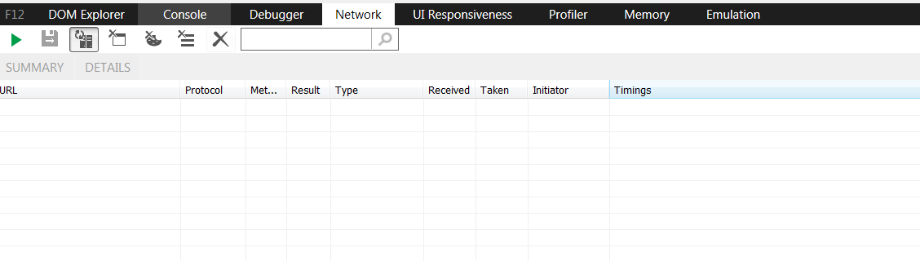
Internet Explorer

Slide 81
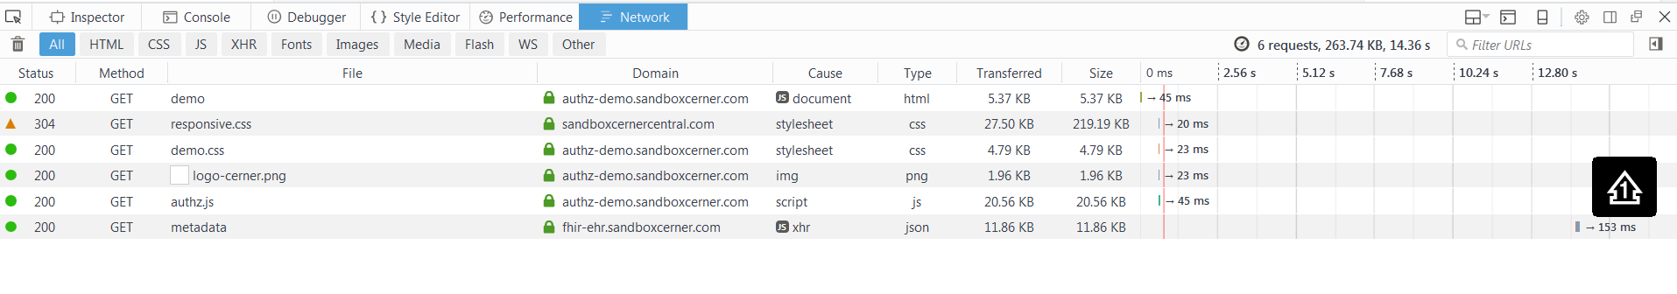
Firefox

Slide 82
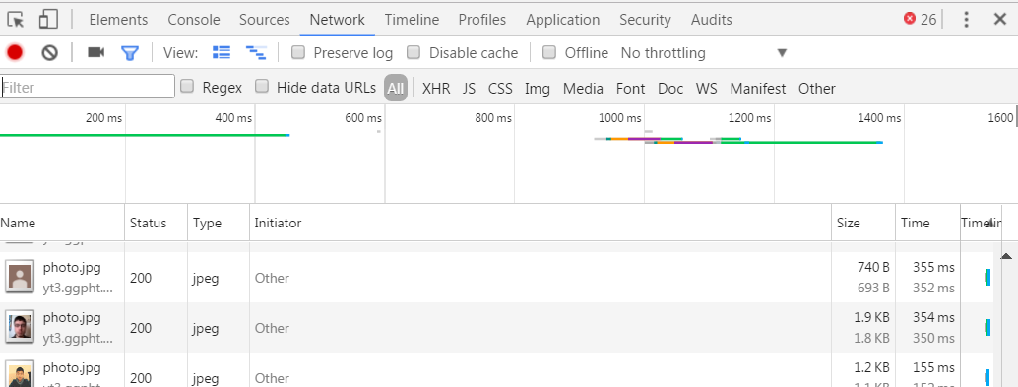
Chrome

Slide 83
Native Applications
AppAuth is an open source library you might consider when developing native applications; it implements all of the best practices recommended by the specifications:
https://appauth.io/

Slide 84
Native Applications
Why this approach for native?
Enables sharing of persistent state between all instances of the browser, both in apps and the system browser.
In turn, this enables single sign-on and single log-out experiences to be offered.
Use of actual browser ensures compatibility with anti-phishing protection mechanisms and device authentication schemes (MDM).

Slide 85
Other Recommendations
Read the specifications and our comprehensive authorization guide @ fhir.cerner.com
Create a Threat Model for your Application
Stay Up to Date With Industry Changes
https://groups.google.com/d/forum/smart-on-fhir
https://tools.ietf.org/wg/oauth/

Slide 86
Q&A
Notes:
SECTION SLIDE: Right-click image to replace.
**Slide not built in master slides due to the ability to swap out images.

Slide 87
“System” Access
SMART® on FHIR® also describes a methodology for direct system-to-system security interactions.
For “system” actors, the “Client Credentials” flow is utilized. This is sometimes referred to as “B2B” or “Backend Services”.

Slide 88
“Client Credentials” Flow
+---------+ +---------------+
| | | |
| |>--(A)- Client Authentication --->| Authorization |
| Client | | Server |
| |<--(B)---- Access Token ---------<| |
| | | |
+---------+ +---------------+
Figure 6: Client Credentials Flow

Slide 89
“System” Access
Steps:
Discover the “token” endpoint via the FHIR® Conformance document.
Make a token request, including your client credentials.

Slide 90
“System” Access
Client credentials are sent using the HTTP Basic Authentication scheme.
For Cerner FHIR® services, credentials are issued via Cerner Central System Accounts.

Slide 91
“System” Access
Scopes for system access:
FHIR® scopes are prefixed with “system” to denote that access is on behalf of a system, not a user. They cannot be mixed with “user” or “patient” scopes.
You may request fewer scopes than your system is authorized to access – this is useful if you want to pass such tokens off to other components in your architecture that are “less trusted”.

Slide 92
“System” Access
Note: Few Cerner FHIR® services currently support direct access via client credentials grant. Refer to the documentation of the individual service.

Slide 94
Notes:
SECTION SLIDE: Right-click image to replace.
**Slide not built in master slides due to the ability to swap out images.

